Slide 1

16-bit Adder with Manchester Carry Ahead.
Presented By
Ashikur Rahman Bhi
ET193069
Chowdhury Arap Mahamud Recap
ET193068
Pranta Paul
ET193089
Supervised By
Engr. Riazul Islam
Lecturer,
Dept. of EEE
IIUC

Slide 2
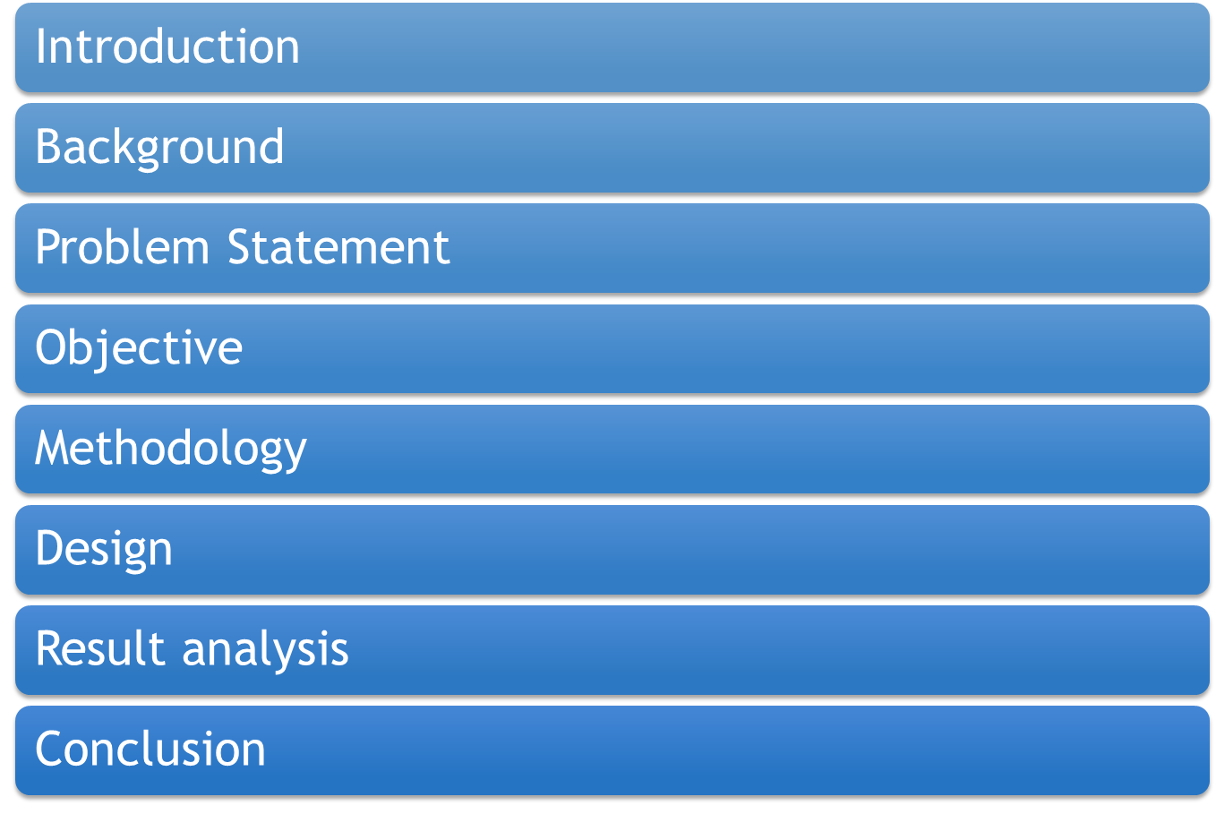

Slide 3

INTRODUCTION
Adders are fundamental building blocks in digital electronics and computing. They are circuits designed to perform binary addition, the core operation behind most arithmetic functions in digital systems. Adders are not only essential for simple calculations but also serve as the foundation for more complex arithmetic operations, such as subtraction, multiplication, and division, which are widely used in various applications like media signal processing, computer processors, and embedded systems
As technology evolves, there is a growing emphasis on designing faster, smaller, and more energy-efficient adders to meet the demands of modern computing. From the basic Half Adder (HA) to more advanced structures like the Carry Look-Ahead Adder (CLA) and Kogge-Stone Adder (KSA), various adder architectures have been developed to optimize speed, area, and power consumption.
In this presentation, we will explore the different types of adders, their operation, and their significance in modern digital systems, along with the challenges and innovations in designing efficient adder circuits.
3

Slide 4
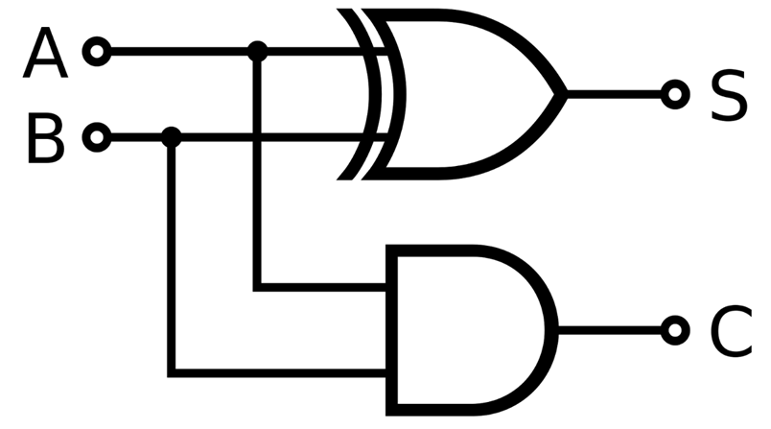
BACKGROUND
A basic adder known as the Half Adder (HA) performs simple binary addition of two input bits using just an XOR gate (for the sum) and an AND gate (for the carry). The structure and behavior of a half adder can be understood through its logic circuit and accompanying truth table.
A | B | S | C
0 | 0 | 0 | 0
0 | 1 | 1 | 0
1 | 0 | 1 | 0
1 | 1 | 0 | 1
Fig 01: Half Adder design
Table 1 The truth table of a Half Adder
4

Slide 5
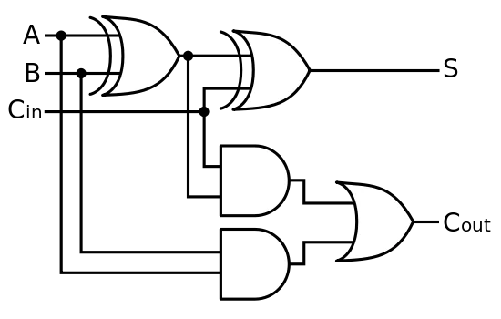
BACKGROUND
By Combining two Half adders together we can process the outputs of the Carry along with the sum.
A | B | Cin | S | C
0 | 0 | 0 | 0 | 0
0 | 0 | 1 | 1 | 0
0 | 1 | 0 | 1 | 0
0 | 1 | 1 | 0 | 1
1 | 0 | 0 | 1 | 0
1 | 0 | 1 | 0 | 1
1 | 1 | 0 | 0 | 1
1 | 1 | 1 | 1 | 1
Fig 02: Full Adder design
Table 2 The truth table of a Half Adder
5

Slide 6
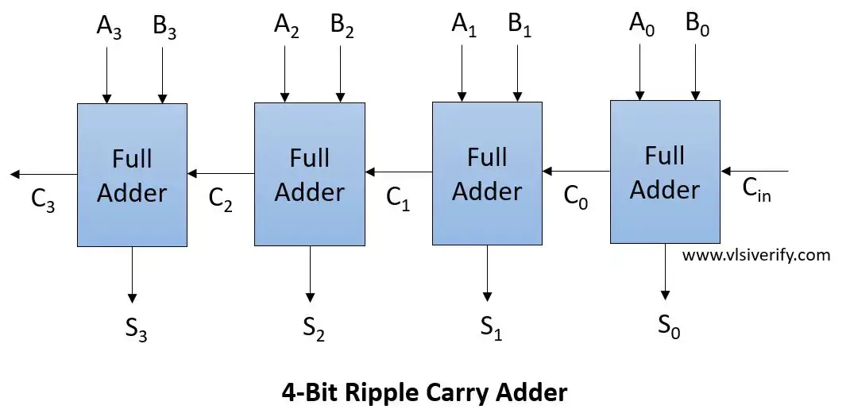
BACKGROUND
By Combining Full Adders in a series in this method we can calculate the sum but it is a slow method as we need to process each bit in steps and cannot skip bits for a faster computation required for multiplication.
Delay in RCA: To calculate the most significant bit we need to calculate the previous bit which needs to be processed from the least significant bit.
Fig 03: Ripple carry Adder design
6

Slide 7
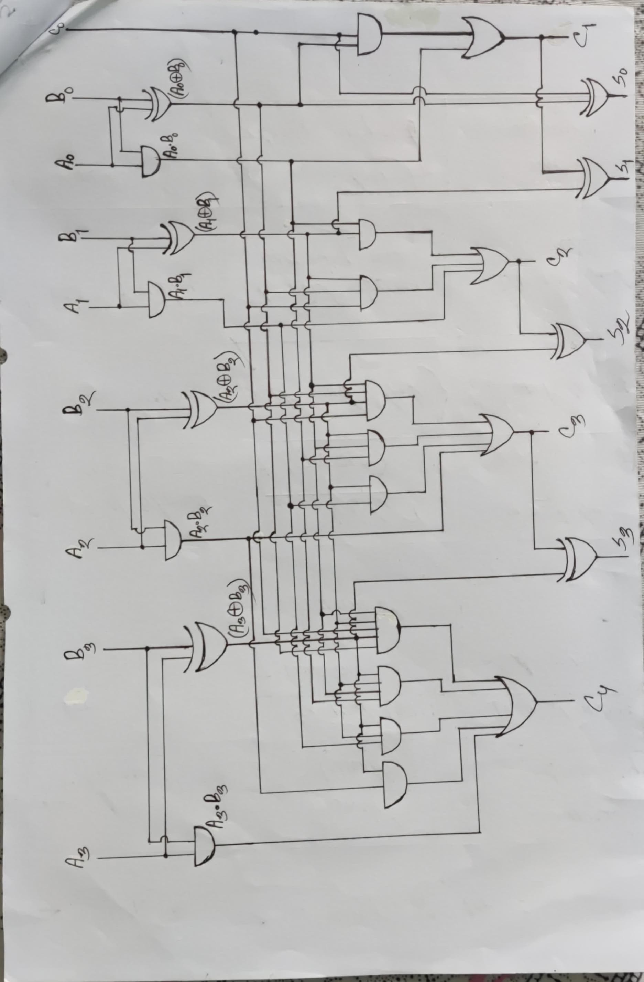



BACKGROUND
The circuit that is shown in Fig 4 is an additional circuit that calculates the carry separately.
By doing so we can calculate the sum much faster then that of the ripple carry as we do not have to take the least significant bit.
Fig 04: Carry Look Ahead Carry Calculation Block
7

Slide 8
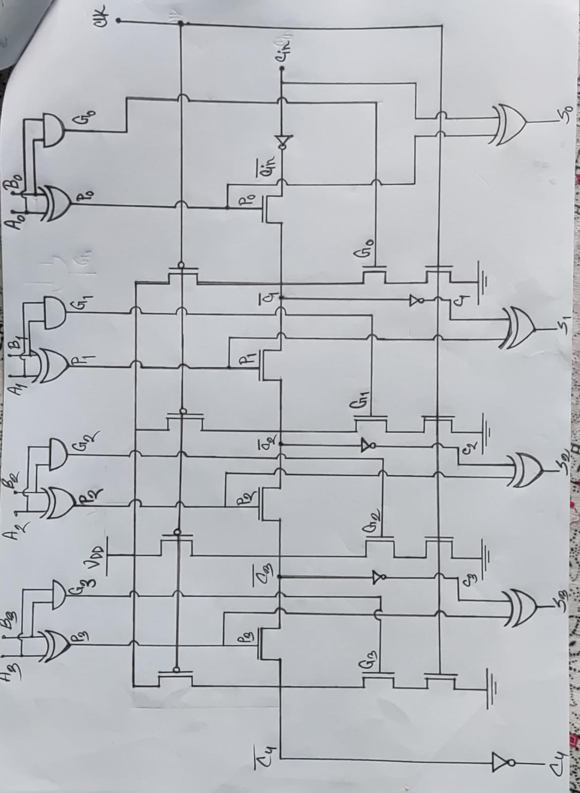
BACKGROUND
The circuit that is shown in Fig 5 is an additional circuit that calculates the carry separately.
This Circuit differs from the CLA block by not using any Logic gates.
Fig 05: Conventional Manchester Carry Adder Carry Calculation
7

Slide 9
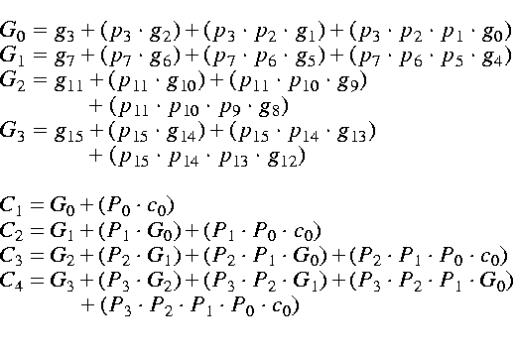
BACKGROUND
Instead of waiting for each carry to be produced sequentially (as in ripple-carry addition), all carries are computed in parallel using this formula.
Carry Look-Ahead Calculation is essential for building fast arithmetic circuits like those found in modern CPUs and DSPs. It improves the speed of addition operations, which are fundamental to computer performance.
7

Slide 10
LITERATURE REVIEW
Researcher | Year | Contribution | Drawback
Padmanabhan Balasubramanian and Nikos E. Mastorakis[1] | 2022 | Use of CLA Adder for an advanced design | Uses logic gates which are more complex.
Vellingiri GOVINDARAJ, Ezhılazhagan CHENGUTTUVAN, Dhanasekar SUBRAMANIYAM[2] | 2022 | Use of CSKA Adder for a FIR design using bypass. | It uses Ripple carry adder with logic gates and a slow design.
P Das, A L Bhalerao, A Mane, A Angeline A and V S K Bhaaskaran[3] | 2019 | Use of Manchester carry adder with HSD. | The design does not use any bypass system.

Slide 11
PROBLEM STATMENT
Reduce the power consumption
01
02
Reduce Rise time and Fall time
03
Reduce circuit complexity
6

Slide 12
OBJECTIVES
01
A new adder design using existing designs
02
To improve the rise time and fall time for the circuit
03
To calculate the power consumption of the circuit.
6

Slide 13
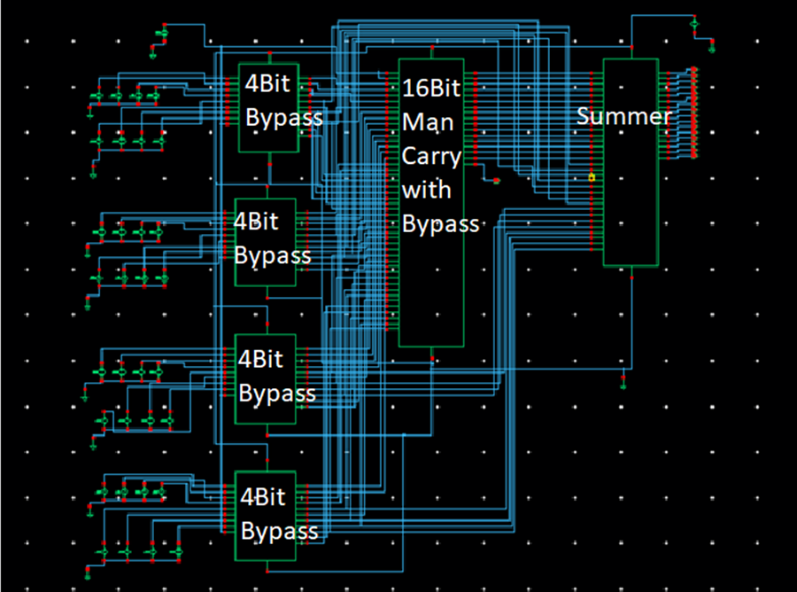
METHODOLOGY
The overall system block
Diagram contains the various components of the Adder
Fig 06: System Block Diagram
7

Slide 14
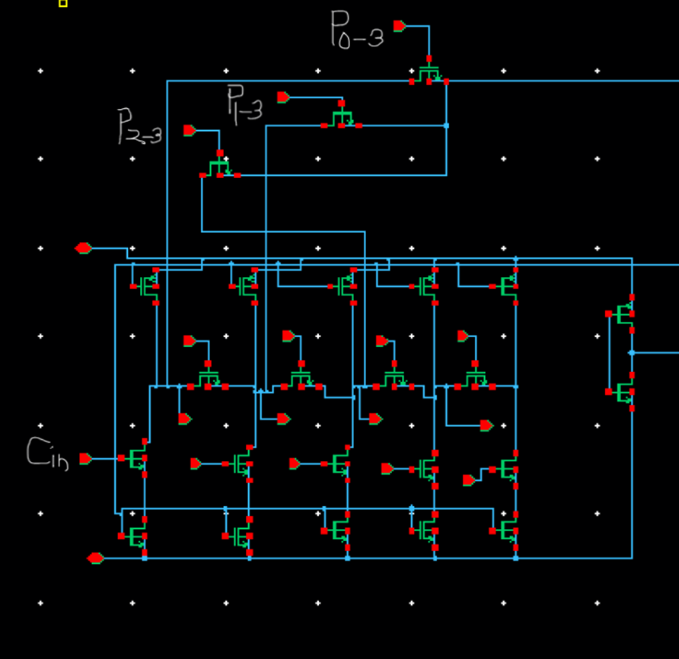
METHODOLOGY
The Type I cell incorporates one intercell
and two intracell bypass transistors,
specifically P0−3P_{0-3}P0−3​, P1−3
P_{1-3}P1−3​, and P2−3P_{2-3}P2−3​.
The presence of P0−3P_{0-3}P0−3​
enables the carry input Cin​
to propagate swiftly to the Type II cell.
Fig 07: Type I Cell
7

Slide 15
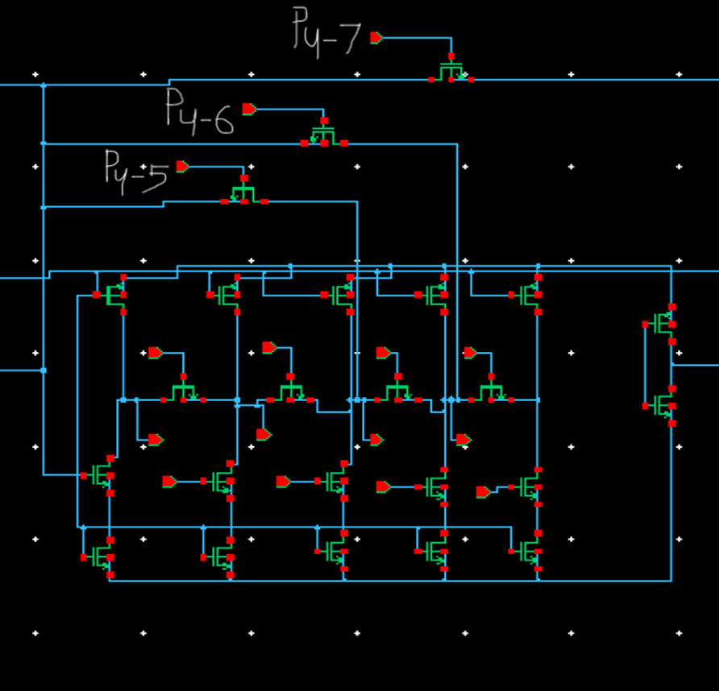
METHODOLOGY(CONT)
Topologically, the Type II and Type III
cells share the same structure;
their only distinction lies in transistor sizing,
which will be addressed later.
The transistors P8−11P_{8-11}P8−11​
enable the standard carry-skip function
across blocks of bits when all
propagate signals within the block are high.
Fig 08: Type II Cell
15

Slide 16
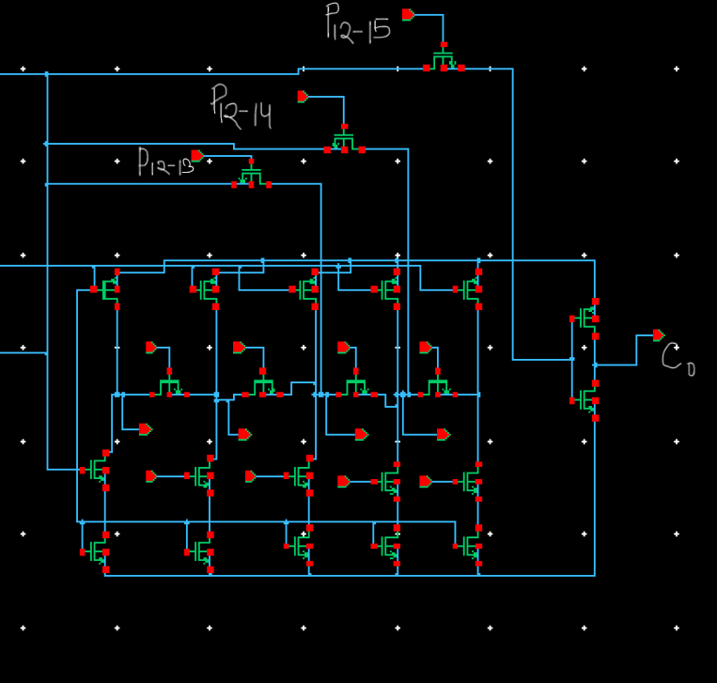
METHODOLOGY(CONT)
The type IV cell differs from type II
and type III cells for both transistor
sizing and placement of the intercell
bypass transistor (P_(12-15)).
The transistor P_(12-15) perform the
usual skip action on blocks of bits when
all the propagate signals into the blocks
are high.
Fig 09: Type IV Cell
16

Slide 17
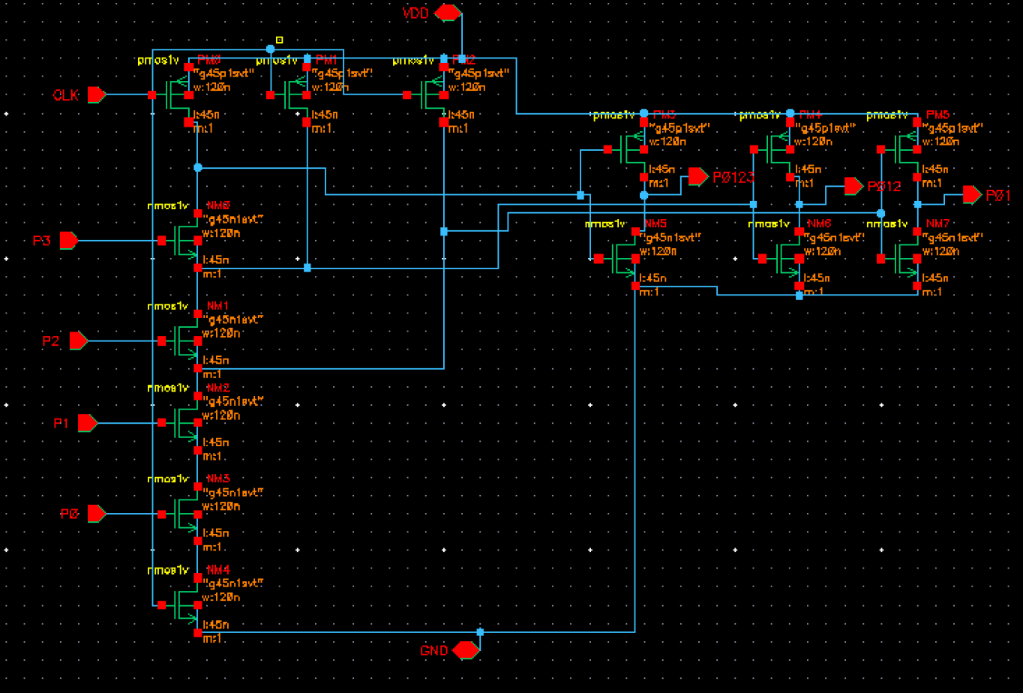
METHODOLOGY(CONT)
The intercell and intracell bypass transistors are controlled by signals Pi−jP_{i-j}Pi−j, which are generated by a multiple-output domino logic gate depicted in Fig. 6
Fig 10: Multiple-output domino logic gate used to compute P_(i-j)
17

Slide 18
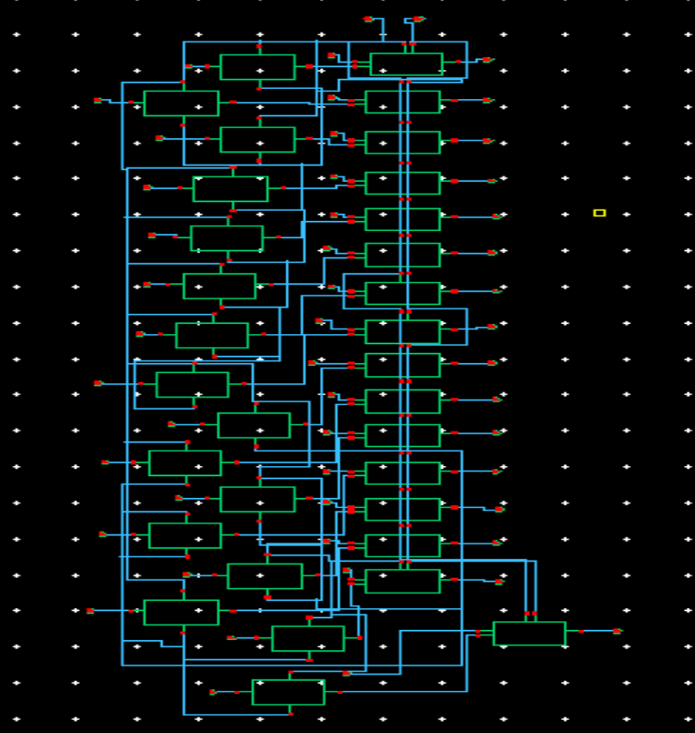
METHODOLOGY(CONT)
The carry is combined with the generate output of the half adder after that we can obtain the sum of the inputs from the summer. Each block has its bypass signal and by bypassing it we make it faster and by using a summer we can obtain the sum independently.
Fig 11: Summer Circuit used in design
18

Slide 19
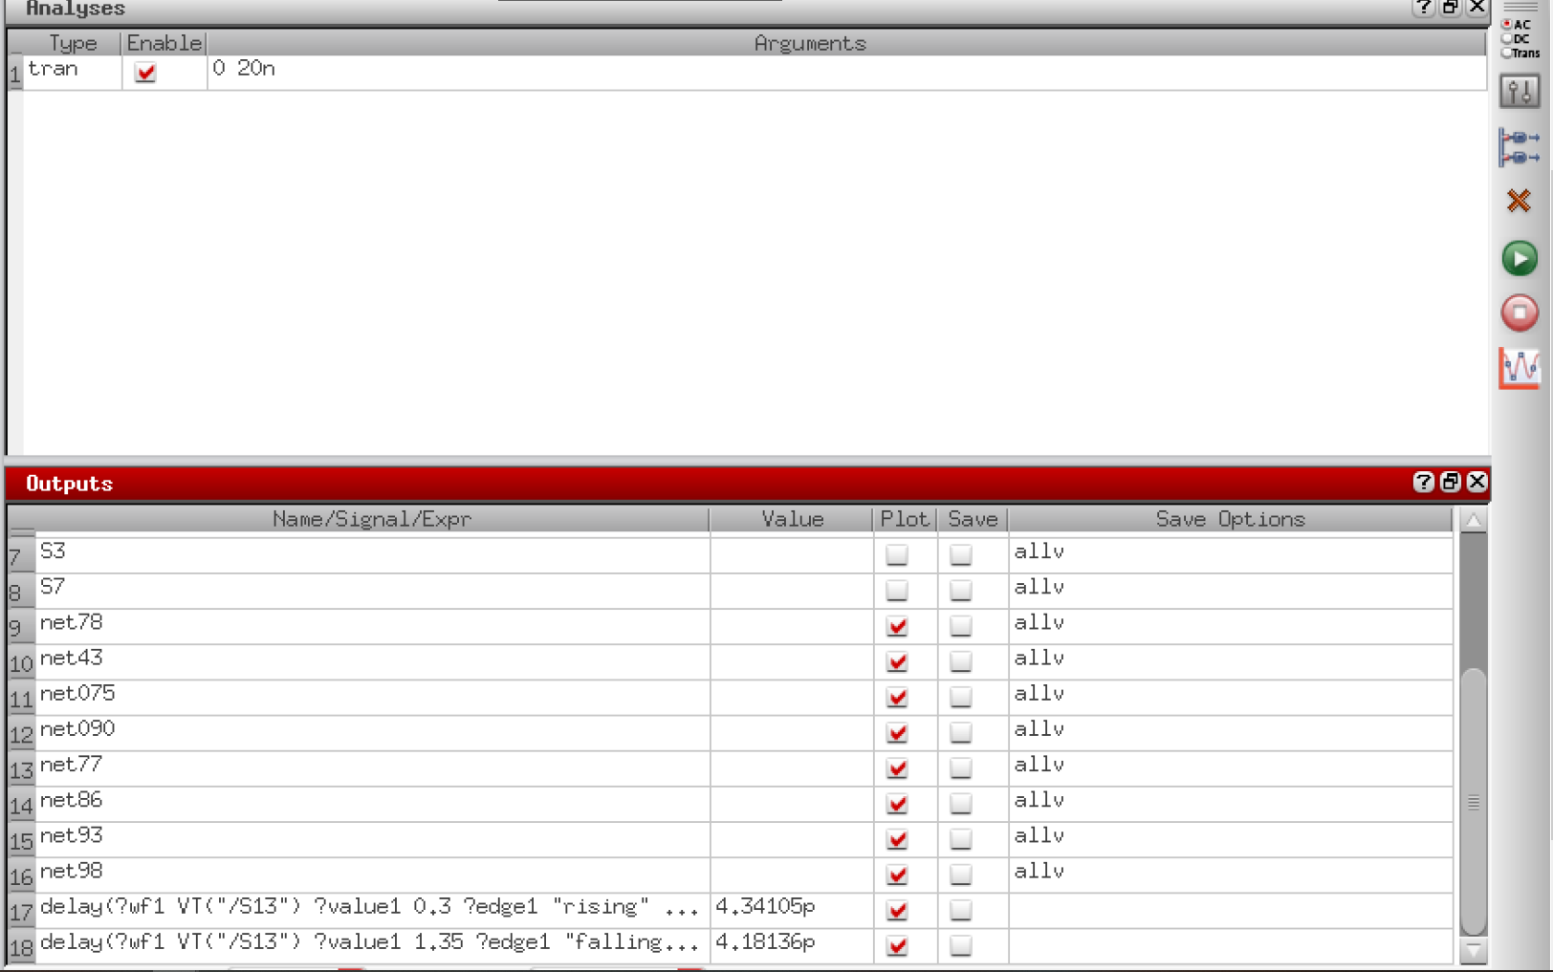
IMPLEMENTATION
This is the Cadance setting for the simuation of the circuit
Fig 12: Simulation parameters and analysis type
12

Slide 20
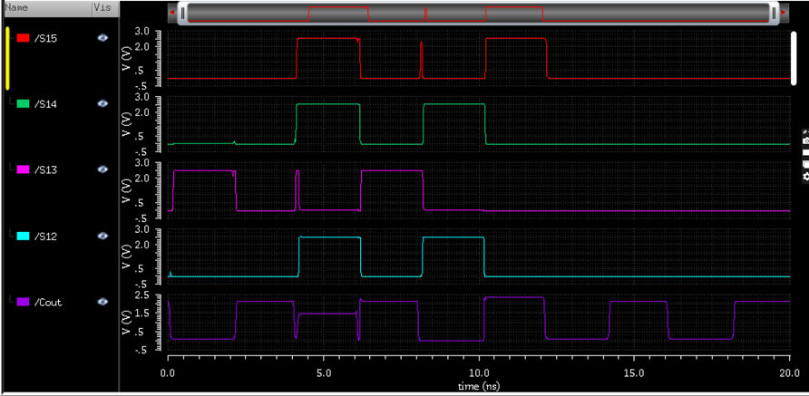
Simulation
Sum Output of adder
for bits 12 to 15
Fig 09: Sum Output of Adder from simulation
12

Slide 21
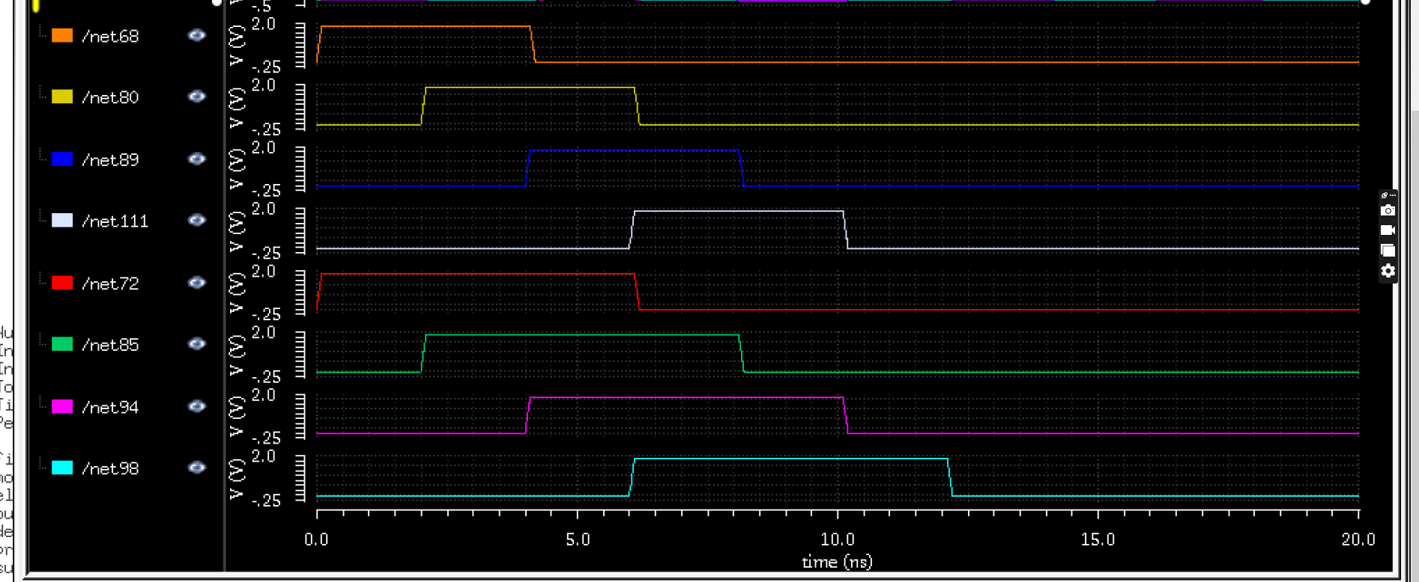
Simulation(CONT)
Fig 10: Input Signals for Adder
The Fig 10 shows the Input signal for the adder for bits 12 to 15 and the correspond to the out put of previous slide.

Slide 22
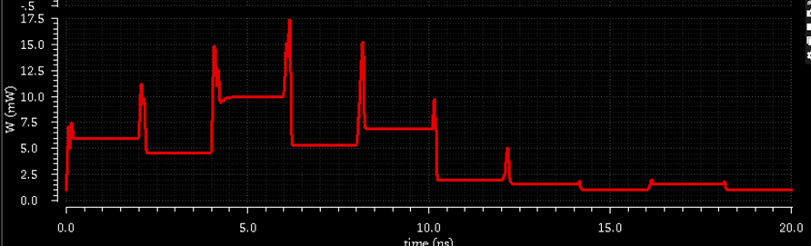
Simulation(CONT)
Fig 11: Output of the power Consumption of the circuit
The Fig11 shows the Power Consumption of the circuit and the fluctuations on the graph are those of the logicoperations of the circuit when the power consumption is the highest.

Slide 23
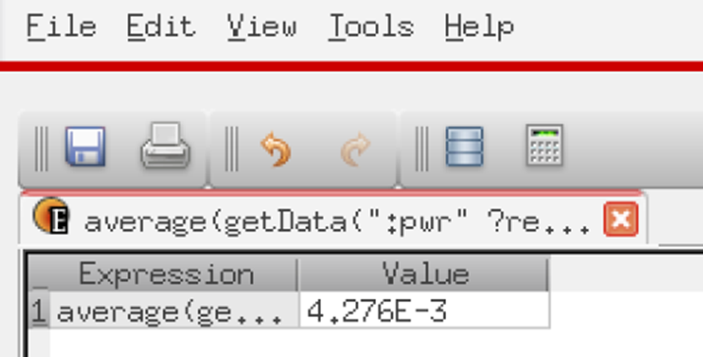
RESULT ANALYSIS
Fig 12: The average power of the adder
As we can see from the average power is calculated by using the calculator function of the software.

Slide 24

RESULT ANALYSIS(CONT)
Fig 13 : Rise and Fall time of the Adder
As we can see from above Rise Time and Fall time is calculated by using the calculator and the output of the calculator is shown in the main interface of the software

Slide 25
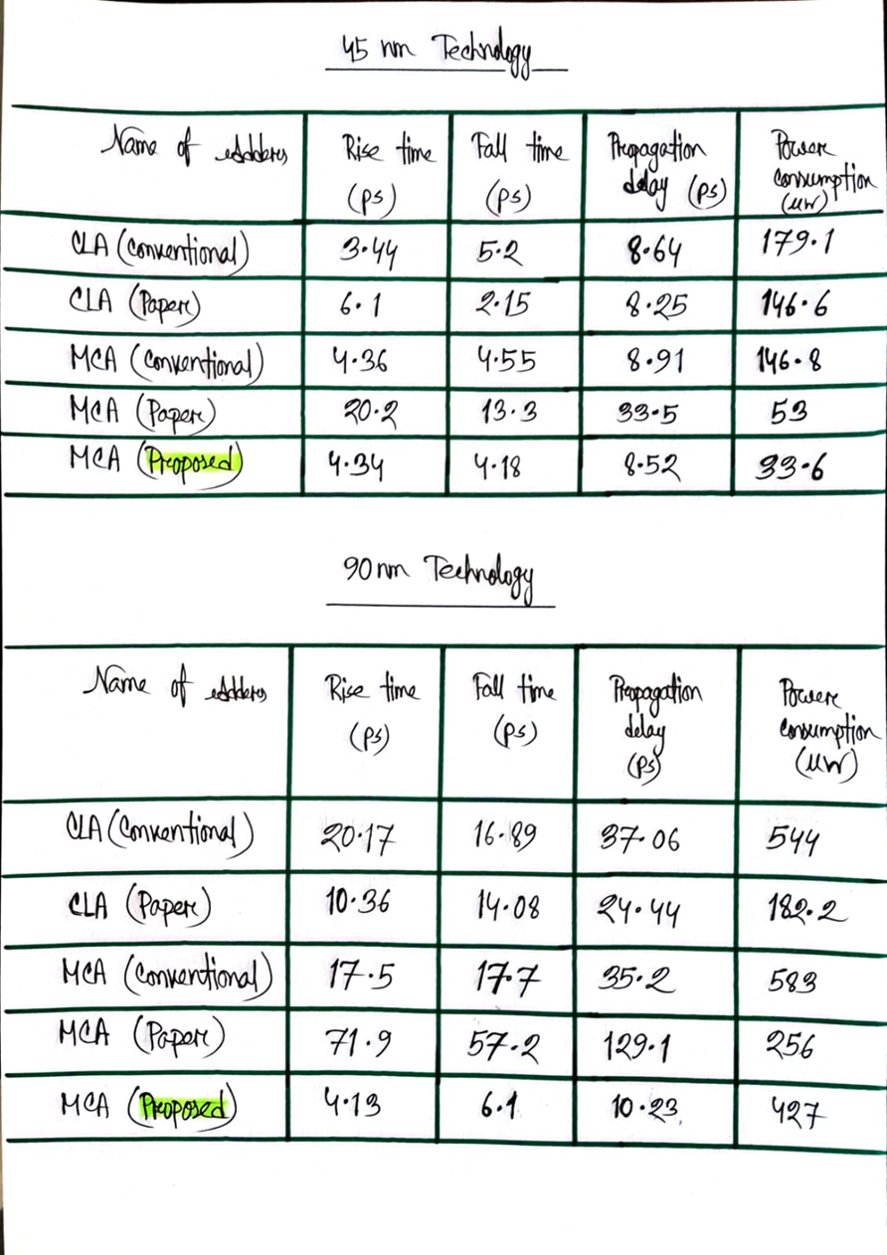

Comparison
Table1 : Performance Comparison of Various Adders(45nm)
19

Slide 26
Comparison
Table2 : Performance Comparison of Various Adders (90 nm)
19

Slide 27
CONCLUSION
As technology advances and the demand for high-performance, low-power systems continues to grow, the importance of optimizing adder designs becomes even more critical. By understanding the strengths and limitations of various adder types, engineers can make informed decisions when developing processors, signal processing units, and other digital systems.
Ultimately, mastering adder design is not just about improving basic arithmetic operations—it's about enabling faster, smarter, and more energy-efficient computing for the future

Slide 28
REFERENCES
[1]P. Das, A. L. Bhalerao, A. Mane, A. A Angeline, and V. S. K. Bhaaskaran, “Design of Manchester Carry Chain Adder using High speed Domino Logic,” IOP Conference Series: Materials Science and Engineering, vol. 561, no. 1, p. 012125, Oct. 2019, doi: 10.1088/1757-899X/561/1/012125.
[2]G. V, E. CHENGUTTUVAN, and D. SUBRAMANIYAM, “Design of Power and Area Efficient Carry Skip Adder and FIR filter Implementation,” El-Cezeri Fen ve Mühendislik Dergisi, Dec. 2022, doi: 10.31202/ecjse.1162711.
[3]P. Balasubramanian and N. E. Mastorakis, “High-Speed and Energy-Efficient Carry Look-Ahead Adder,” Journal of Low Power Electronics and Applications, vol. 12, no. 3, p. 46, Aug. 2022, doi: 10.3390/jlpea12030046.

Slide 29
THANK YOU

